Slide 1
Performance Evaluation and Analysis of Machine Learning Algorithms in Stock Price Prediction
Gaurab Shrestha

Slide 2
INTRODUCTION

Slide 3
Background
All stock markets' total global capitalisation exceeded $111 trillion by 2023.
With the broad financial market increase, people are interested in stocks, trading, etc.
Stock – Capital raised by any company through the issue and subscription of shares whose value is dynamic throughout time
Stock Market - A combined platform of several markets and exchangers where various investors sell and purchase according to the availability of stocks.

Slide 4
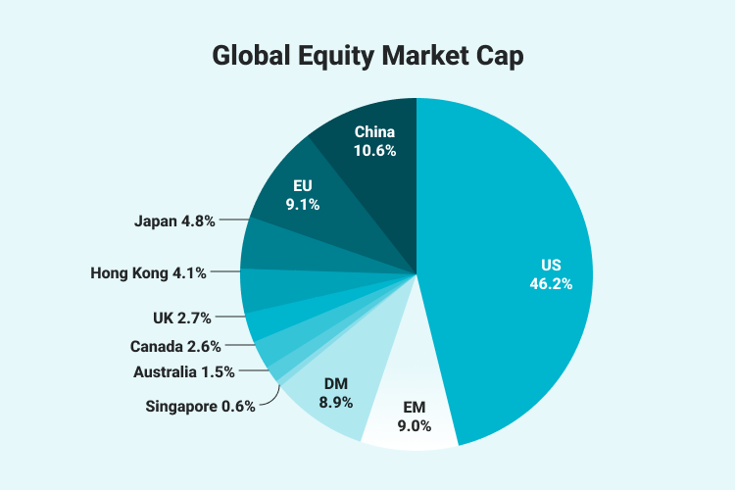
Global Equity Market Cap (Sahm Investor Education, 2023)

Slide 5
Problem Statement
As stock market is increasing, several methods of predicting the stock prices are being developed.
Many researchers have developed numerous machine learning and deep learning algorithms for stock price prediction.
With increase in these algorithms to predict the stock prices, their performance and prediction accuracy should be studied with the effect of data, characteristics of stock trends.

Slide 6
Objectives
The primary objective of our dissertation is to “Evaluate and analyze the performance of machine learning algorithms in stock price prediction”
Some other objectives are:
Evaluate the effectiveness of various machine learning techniques in predicting stock prices
Identify the most effective machine learning model for stock price forecasting.
Assess the impact of the stock trends, data used for training the machine learning algorithms.

Slide 7
LITERATURE REVIEW

Slide 8
Basic Machine Learning Approaches
Different researchers used different ML algorithms to predict stock prices. Some are:
(Pathak & Pathak, 2020) conducted and compared research on stock price prediction using basic machine learnings like RF, SVM, KNN, and LR.
(Kabir, et al., 2023) also presented a research paper on stock price prediction using basic machine learning algorithms, such as LR, SVM, DT, and RF.
(Khanna, et al., 2022) studied four prediction models: LSTM, XGBoost, SVM and RF.

Slide 9
Deep Learning Approaches
(Mehtab & Sen, 2019) proposed a hybrid approach for predicting stock prices using ML, DL and NLP.
(Rizvi & Khalid, 2024) explored stock market analysis using different deep learning algorithms like MLP, LSTM, and GRU to provide a comprehensive performance analysis of these algorithms.
(Saud & Shankya, 2019) examined and compared the stock price prediction performance with GRU and its optimisation algorithms like ADAM, RMSProp, Momentum, etc.

Slide 10
METHODOLOGY

Slide 11
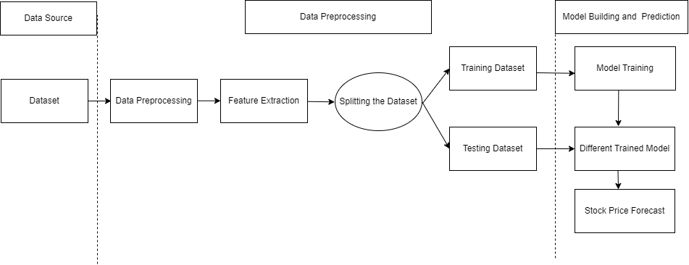
Project System Design Overview

Slide 12
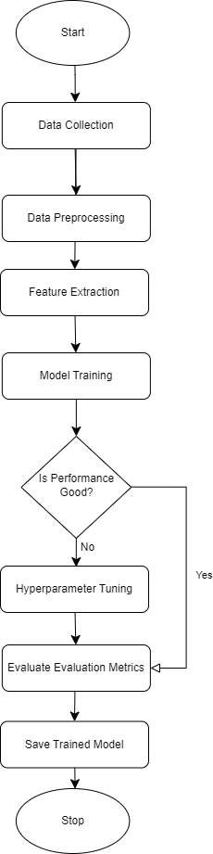
Project Flowchart

Slide 13
Data Collection
Two dataset used: Google Stock Price Dataset and Nabil Bank Stock Price Dataset
Google Stock Dataset is taken from Yahoo Finance, and Nabil Bank Dataset is scrapped from the Share Sansar website.
Features like Open, High, Low and Volume is taken to predict Close price.

Slide 14
Dataset Overview
Columns | Description | Count |  | Missing Values
Stock Price Dataset |  | Google | Nabil | Google | Nabil
Date | Date on which the stock is documented | 5060 | 3083 | 0 | 0
Open | Initial listed price of the stock for a trading day | 5060 | 3083 | 0 | 0
High | Peak price of the stock exchanged during a particular trading day | 5060 | 3083 | 0 | 0
Low | Lowest price of the stock exchanged during a specific trading day | 5060 | 3083 | 0 | 0
Close | Final trading price of the stock at the conclusion of a trading session | 5060 | 3083 | 0 | 0
Volume | Total volume of shares exchanged within a certain timeframe | 5060 | 3083 | 0 | 0

Slide 15
Data Splitting Method
Two methods are employed to split the dataset into train and test sets.
The first one is train_test_split() from sklearn.model_selection, but it hampers the sequential patterns of the time series data.
First 80% data as train set (Sequential Splitting)

Slide 16
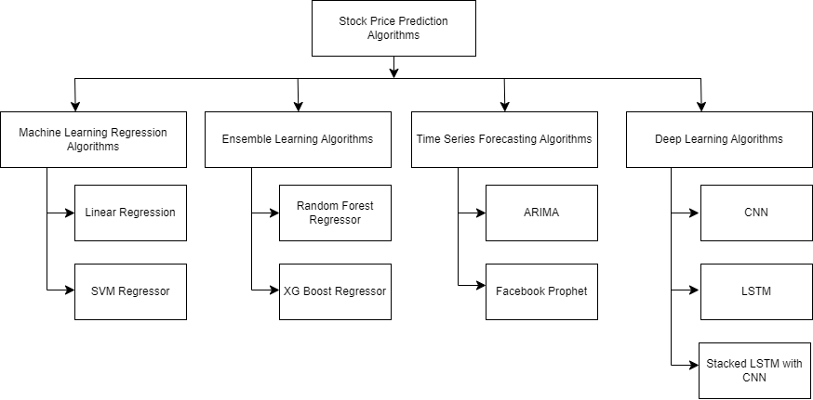
Model Building

Slide 17
Hyperparameter Tuning
We used Grid Search method for basic machine learning algorithms and Random Search for deep learning for hyperparameter tuning.
For basic machine learning algorithms, regularization parameter, kernel, max_depth, n_estimators, etc are tuned.
For deep learning algorithms, kernel number, kernel size, dropout layer rate, dense layer rate, learning rate are tuned.

Slide 18
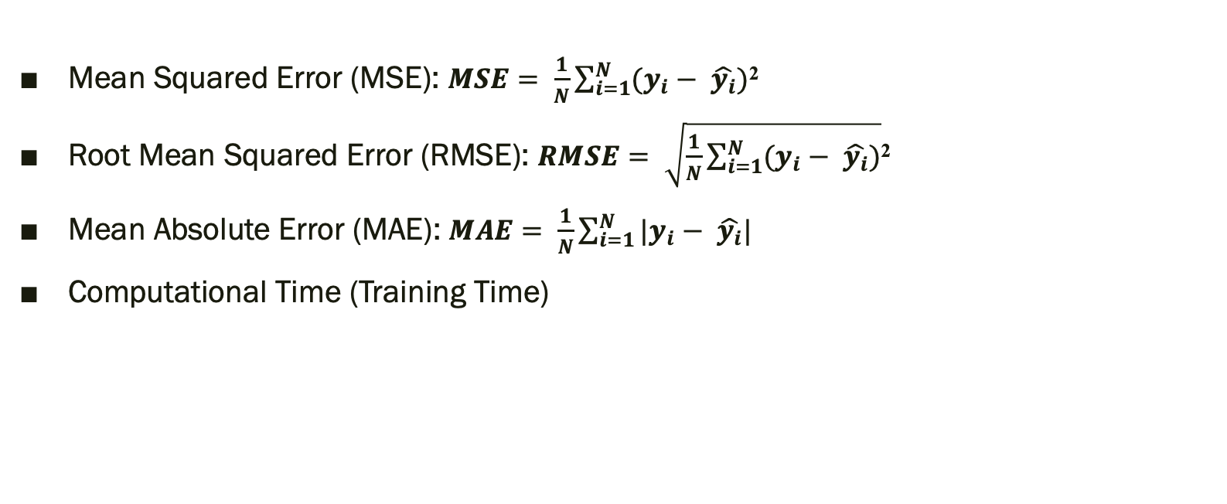
Performance Evaluation Metrics
Mean Squared Error (MSE): $MSE= \frac{1}{N}\sum_{i=1}^{N}{(y_{i}}− \hat{y_{i}})$²
Root Mean Squared Error (RMSE): $RMSE= \sqrt{\frac{1}{N}\sum_{i=1}^{N}{(y_{i}}− \hat{y_{i}})}$²
Mean Absolute Error (MAE): $MAE= \frac{1}{N}\sum_{i=1}^{N}{|y_{i}}− \hat{y_{i}}|$
Computational Time (Training Time)

Slide 19
RESULTS, ANALYSIS AND DISCUSSION

Slide 20
Results from Google Stock Price Dataset – Performance Metrics
Algorithm | Mean Squared Error (MSE) |  | Root Mean Squared Error (RMSE) |  | Mean Absolute Error (MAE) |  | Training Time (sec)
 | Train Test Split | First 80% Train | Train Test Split | First 80% Train | Train Test Split | First 80% Train | Train Test Split
LR | 0.168 | 0.653 | 0.410 | 0.808 | 0.218 | 0.626 | 0.023
SVM | 0.167 | 0.660 | 0.409 | 0.812 | 0.217 | 0.630 | 1.283
RF | 0.415 | 2365.704 | 0.644 | 48.638 | 0.325 | 41.600 | 2.320
XGB | 0.614 | 2773.901 | 0.784 | 52.667 | 0.374 | 46.262 | 2.679
CNN | 6.372 | 197.659 | 2.524 | 14.059 | 1.747 | 13.114 | 131.116
LSTM | 1.879 | 34.076 | 1.371 | 5.837 | 0.741 | 4.745 | 1934.98
CNN-LSTM | 11.416 | 2234.370 | 3.378 | 47.269 | 2.853 | 40.717 | 201.006
SARIMAX | 0.846 | 9.485 | 0.920 | 3.079 | 0.768 | 2.689 | 30.902
FB-Prophet | 193.277 |  | 13.902 |  | 10.923 |  | 6.552

Slide 21
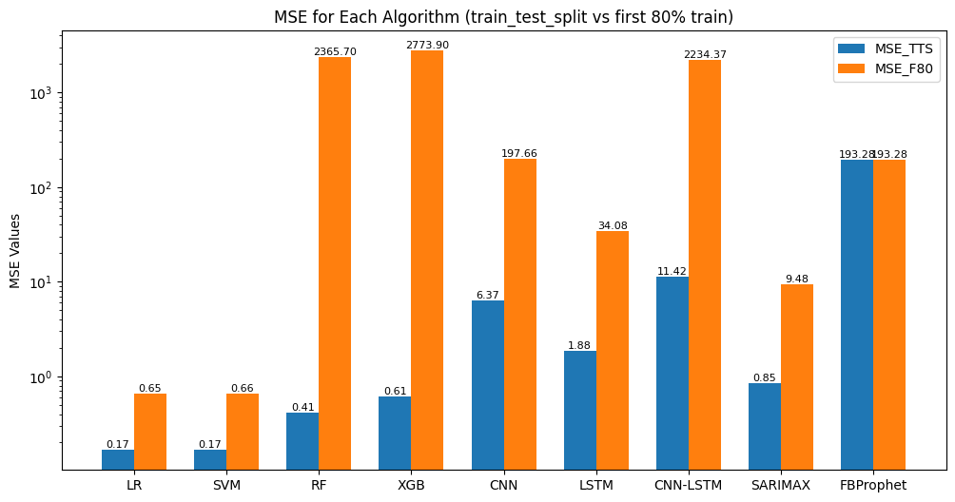
Google Stock Price Dataset – MSE

Slide 22
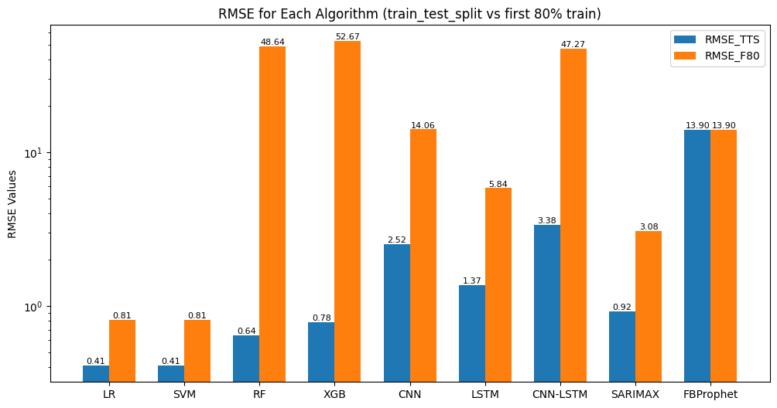
Google Stock Price Dataset – RMSE

Slide 23
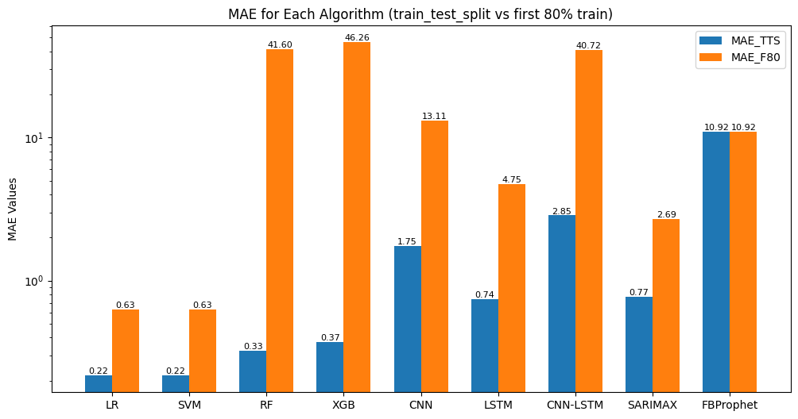
Google Stock Price Dataset – MAE

Slide 24
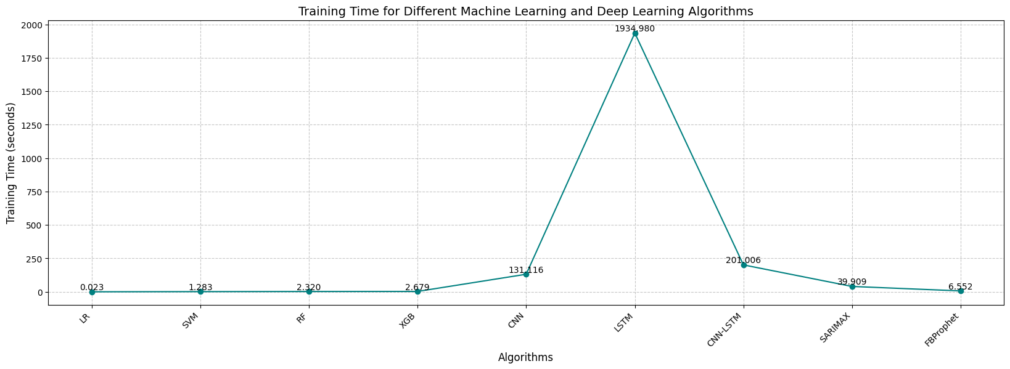
Training Time

Slide 25
Results from Nabil Stock Price Dataset – Performance Metrics
Algorithm | Mean Squared Error (MSE) |  | Root Mean Squared Error (RMSE) |  | Mean Absolute Error (MAE) |  | Training Time (sec)
 | Train Test Split | First 80% Train | Train Test Split | First 80% Train | Train Test Split | First 80% Train | Train Test Split
LR | 176.76 | 32.13 | 13.10 | 5.66 | 8.76 | 4.17 | 0.031
SVM | 179.88 | 290.18 | 13.411 | 17.03 | 8.89 | 12.22 | 1.001
RF | 254.34 | 10885.80 | 15.94 | 104.33 | 9.84 | 71.79 | 2.255
XGB | 282.95 | 11862.64 | 16.82 | 108.91 | 10.66 | 76.59 | 1.234
CNN | 2417.73 | 38259.15 | 49.17 | 195.59 | 34.01 | 150.12 | 91.938
LSTM | 1863.13 | 1984.71 | 43.16 | 44.55 | 24.66 | 39.87 | 966.430
CNN-LSTM | 7682.09 | 17683.82 | 87.64 | 132.95 | 58.81 | 111.23 | 135.355
SARIMAX | 12919.91 | 14843.97 | 113.66 | 121.84 | 99.69 | 104.39 | 93.043
FB-Prophet | 10493.07 |  | 102.43 |  | 86.13 |  | 6.603

Slide 26
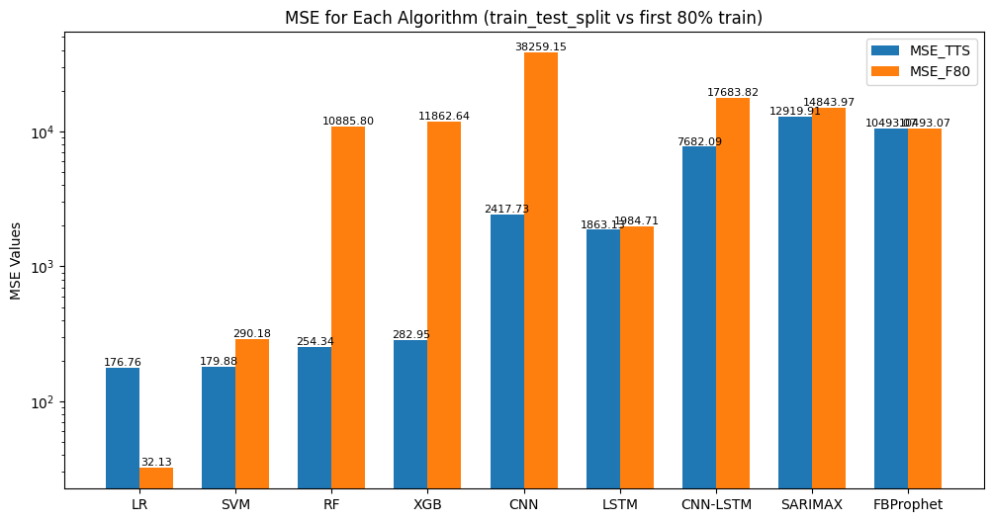
Nabil Stock Price Dataset – MSE

Slide 27

Nabil Stock Price Dataset – RMSE

Slide 28
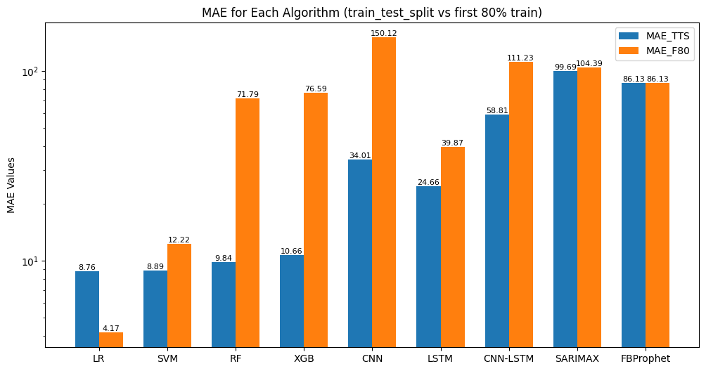
Nabil Stock Price Dataset – MAE

Slide 29
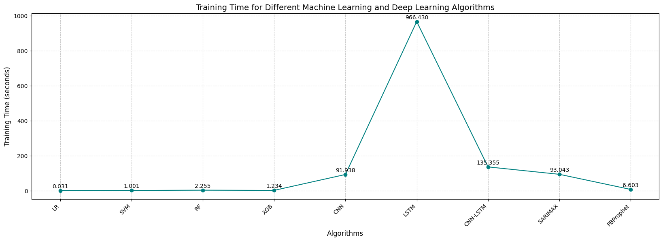
Training Time

Slide 30
Analysis of Result: Performance of Different Models
Basic machine learning algorithms like LR and SVM outperformed more complex models like RF, XGB, CNN and LSTM.
Tree based ensemble learning methods like RF and XGB are not inherently designed to handle time-series data.
The features we used, like Open, High, Low Prices, and Volume, are linearly or quasi-linearly related to the Close price, so algorithms like LR and SVM are well suited for these types of relations, which don’t complicate the problem.

Slide 31
Analysis of Result: Effect of Data Splitting
The train_test_split() method from sklearn.model_selection produced superior results compared to first 80% data as training set (sequential splitting).
Utilizing train_test_split() method allows for random allocation of data, which helps model to understand the overall pattern of dataset.
Sequential splitting preserves the sequential patterns of time series data but this cause models to have difficulty generalizing if the test dataset includes patterns or trends that weren't present in the training set.

Slide 32
Analysis of Result: Effect of Stock Price Trends
Trends in stock prices have a profound effect on model building.
Google’s stock has a steady upward trend, providing smoother and more predictable patterns for models to learn, allowing simpler algorithms to perform well.
Erratic fluctuation in Nabil Stock data added complexity, requiring models to balance fitting to the observed data.

Slide 33
CONCLUSION

Slide 34
Summary Overview
Performance of different machine learning, deep learning and time series algorithms are evaluated and analyzed with respect to different performance evaluation metrics.
Key Finding 1: Simpler models like LR and SVM outperformed more intricate models including tree-based models like RF and XGBoost and deep learning models like CNN and LSTM.
Key Finding 2: The train_test_split() method produced better performance compared to first 80% data training (sequential splitting) approach.
Key Finding 3: To improve the prediction accuracy of the algorithms, trend of stocks, news sentiments and social media trends should be investigated.

Slide 35
Research Limitations
Market Volatility and Uncertainty
Unpredictable Events
Time Varying Patterns
Model Complexity and Overfitting
Overfitting Risk
Computational Cost
Ethical Considerations and Responsible AI
Fairness and Bias
Transparency and Interpretability
Real World Application and Practical Constraints
Transaction costs and Market Impact
Regulatory and Compliance

Slide 36
Future Research Recommendations
Incorporating External Factors
News Sentiment Analysis
Economic Indicators
Advanced Deep Learning Techniques
Attention Mechanisms
Transformer Models
Hybrid Models
Combining Technical and Fundamental Analysis
Real-time Prediction and Adaption
Online Learning
Real-time Data Streams

Slide 37
References
Pathak, A. & Pathak, S., 2020. Study of Machine Learning Algorithms for Stock Market Prediction. International Journal of Engineering Research & Technology (IJERT), 9(06), pp. 295-300.
Rizvi, D. R. & Khalid, M., 2024. Performance Analysis of Stocks Using Deep Learning Models. 5th International Conference on Innovative Data Communication Technologies and Application - ICIDCA, 233(2024), pp. 753-762.
Saud, A. S. & Shankya, S., 2019. Analysis of Gradient Descent Optimization Techniques with Gated Recurrent Unit for Stock Price Prediction: A Case Study on Banking Sector of Nepal Stock Exchange. Journal of Institute of Science and Technology, 24(2), pp. 17-21.
Mehtab, S. & Sen, J., 2019. A Robust Predictive Model for Stock Price Prediction Using Deep Learning and Natural Language Processing. Proceedings of the 2019 International Conference on Business Analytics and Intelligence (ICBAI 2019), 1 December.

Slide 38
THANK YOU!!

Slide 39
ANY QUESTIONS??

